Slide 1
Who Hugs the Hugger? A Mythology of Self-Care
Presented by Edward M. Smink PhD, BCC.

Slide 2
So what is it about myth?
Myth grounds us into our own personal and cultural identities and
simultaneously allows us to soar into the land of possibilities.

Slide 3
Where does myth take us?
Into the Land of Once upon a time-the call to adventure-Joseph Campbell
Into the depths of being where soul takes us deeper-Hillman
Into that landscape where one finds some hidden ground to stand on, a mythical place that gives one a distinct vantage point and perspective-Hillman
Into our personal and collective identities -Jung

Slide 4
Myths Take us on a Journey
Travel any way you like. You can
Walk
Hike
Sit on the back of a camel
Ride in a rickshaw,
Or sit on an imaginary magic carpet,
as you become a participant in a pilgrimage of magical proportions

Slide 5
Myth allows us to discover and tell our story

Slide 6
Myths allow us to reflect
A fundamental core component of our busy lives is the necessity to stop and rest to ponder, reflect, and grow from our experiences.
So central is the reflection urge within us that Jung maintains it is one of the three psychic energies of the Soul.
.

Slide 7
Creating a Mythology of Self-Care

Slide 8
What is Self-Care?
Self care is about being held

Slide 9
Self Care is About Caregiving
Being a Caregiver and Allowing others to Care for us.

Slide 10
The Caregiver is an essential archetype in human life. None of us would be alive if no one cared for us as a child, and life without mutual giving is joyless. Carol S. Pearson, Author of Awakening the Heroes Within: 12 Archetypes to Find Ourselves and Transform Our World.

Slide 11
Who are the Caregivers?
We All Are

Slide 12
CAREGIVER STRENGTHS

Slide 13
The Caregiver Archetype
Core professional gift:
Support & development
Motto:
Do unto others as you would have them do unto you.
Underlying assumptions/perspective:
People should do whatever is required to help those who need them.
Fundamental question:
Who will this affect?
Copyright 2009, Pearson/Atlee/Spero-Shelley

Slide 14
Strengths:
Providing great service, care or counsel
advocating for and marshalling people resources
creating stable, supportive environments where people can develop/grow/heal
putting structures in place to help others and/or keep them safe from harm
responding to need/offering assistance
modeling servant leadership
Copyright 2009, Pearson/Atlee/Spero-Shelley

Slide 15
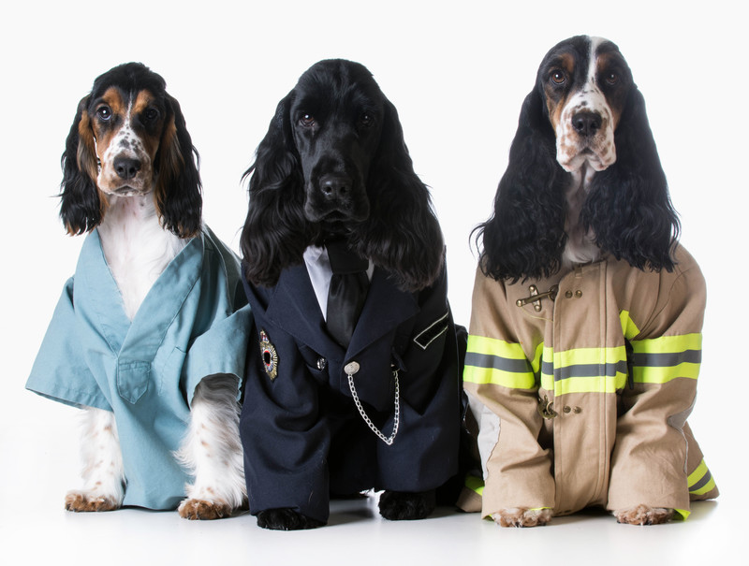

Slide 16
CAREGIVER PITFALLS

Slide 17
Martyrdom,
Enabling others/co-dependency,
Too little self care,
Resentment/guilt tripping,
Taking on too much
Copyright 2009, Pearson/Atlee/Spero-Shelley

Slide 18
Holding back difficult news or tough feedback
Sublimating personal voice/failing to speak up
Failing to connect people
perspective with business outcomes
Lack of managing Compassion Fatigue

Slide 19
What is Compassion Fatigue?

Slide 20
Understanding Compassion Fatigue Do you have trouble in asking for help?
We Experience Compassion Fatigue because we care.
Charles Figley begins his book about compassion fatigue with these words: “There is a cost to caring. Professionals who listen to clients’ stories of fear, pain, and suffering may feel similar fears, pains, and sufferings because they care.

Slide 21
Christina Maslach argues that the symptoms can be
physical, emotional, and spiritual.
Again, caregivers experience these because we care. This is the caregiver’s normal.

Slide 22
Another form of fatigue is called burnout. Maslach (1982) with Goldberg (1998) and Leiter (2003) agree that burnout can be defined “as a psychological syndrome of emotional exhaustion, depersonalization, and reduced personal accomplishment

Slide 23
Digging around one’s roots
Reflection is a truth teller.
The Soul’s voice needs to be heard
Does the inner pain caused by a pattern of living on the surface of things prompt one to go deeper into the depths of one’s Soul?
The outcomes of reflection are a two edge sword revealing both:
The caregiver’s skills, talents, and strengths,
but also the caregiver’s vulnerability, limitations, fears, and wounds seeking to heal.
Michael Kearney writes, “Soul points us inward and downward to the roots of our humanity and suggests that reconnection with our Soul is the central issue.”

Slide 24
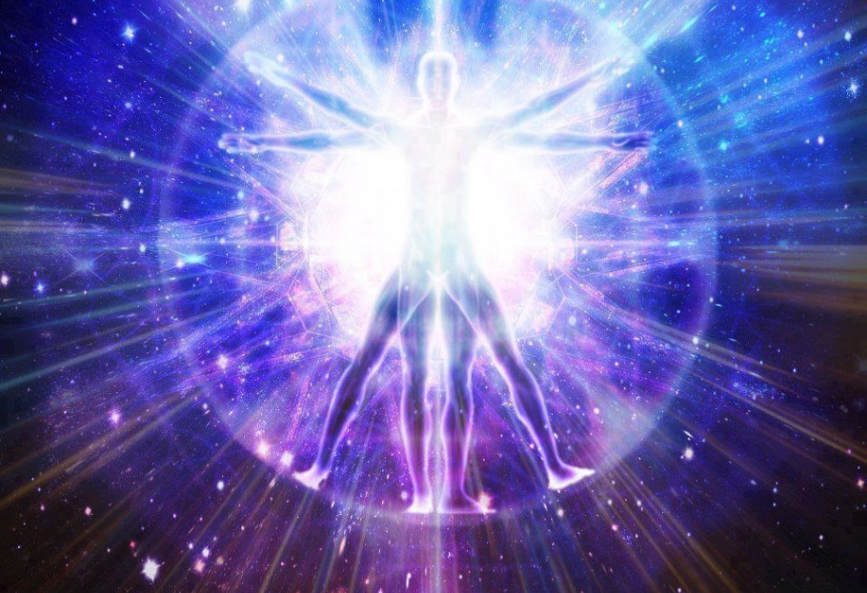
Self Care is about listening to One’s Soul
Soul animates a person, like a work of art, the lyrics of a song, the lines of a poem, the laughter of your grandchild.
Sometimes, time stops, and the silence of the moment seems to never end.
Being soulful and filled with Soul, may evoke deep feelings about yourself or one that you admire.

Slide 25
Self Care is about being Hospitable The Mythology of Hospitality has Ancient Roots

Slide 26
Your Guest is Truly A God from Sanskrit Adage
The guest is truly your god, dictates the respect granted to guests in India.
In offering hospitality, the host would find favor.

Slide 27
Hospitality as a right practiced in Ancient Greece. As prerequisite for Social Standing

Slide 28
Huston Smith quoting a teaching from the Kabala “Every Time a person walks down a street, Choirs of Angles go before each person singing:
“Behold.”
“Behold.”
“Behold.”
“The face of God.”

Slide 29
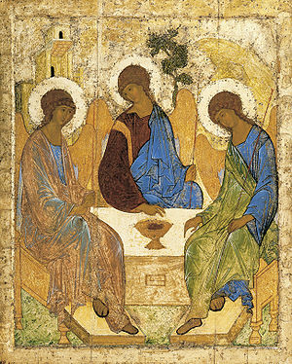
3. Strangers appear in the Hebrew Scriptures
Abraham becomes the host to three visitors (Genesis 18:1ff),
Lot and his wife offer hospitality to two strangers (Genesis 19:1ff).

Slide 30
In Roman Literature Ovid tells the Story of Baucus and Philemon
the Roman poet Ovid retells a Greek myth about Baucus and Philemon who are hosts to two gods, Jupiter and Mercury who are disguised as humans.
Their names would be Zeus and Hermes according to the Greek pantheon of gods.

Slide 31
7. A Christian Perspective
It was a common belief and practice that in welcoming a stranger, you may be welcoming a god.
Matthew speaks about the rewards of the just,
“I was a stranger and you welcomed me.”
(Mat.25:35ff).
Jesus had no home and was frequently a guest.

Slide 32
Jesus At Simon’s House
Paul and Barnabas in Lystra,
Paul exhorts community: “Do not neglect to show hospitality to strangers, for by doing that, some have entertained angels without knowing it.”

Slide 33
North American Hospitality
Be hospitable.
Always assume that your guest is tired, cold, and hungry.
Always give your guest the place of honor in the lodge, and at the feast, and serve him in reasonable ways.
Protect your guest as one of the family; feed his horse.

Slide 34
The first attitude of Hospitality Creating Space to respond to one in need to welcome the stranger.

Slide 35
The Second Attitude of Hospitality Creating space to LISTEN to the story of the one in need.
“When you knock on the door of a patient, take a deep breath and know why you are entering the room.” Dr. Christina Puchalski, In other words, no time for a bad hair day.

Slide 36
US State Department suggest:
To Listen, one must:
use both ears
watch and maintain eye contact
give undivided attention
be empathetic
to seek to understand before you seek to be understood,
to be non-judgmental,
to give the individual (and yourself) your undivided attention
to use silence effectively.

Slide 37
Chinese Symbol of Active Listening

Slide 38
The Third Attitude of Hospitality Creating Space to listen to the Wisdom gleaned from your experience
Are you conscious of the stirrings within your soul. As Hillman suggests, “Afflictions point to gods; gods reach us through afflictions.

Slide 39
Self care is about learning that we are wounded healers.

Slide 40
So when we hurt
or experience a traumatic event,
or don’t understand our struggle in what we are feeling,
or just experiencing the numbness of being overwhelmed,
instead of beating ourselves up,
feeling out of control,
or fearful of what is buried within,
we can begin to accept and learn from the wonderful gift of being human.

Slide 41
Recently the term “wounded healer” has been used synonymously with burnout or impairment of caregivers in the healing professions, comments Len Sperry
Serge Daneault asks the question whether this archetype can assist physicians. He recognizes the Wounded Healer as one who has gone through suffering and as a result of that experience becomes a source of great wisdom, healing, and inspiration for others.
Dr. Martin Lipp adds: “My wounds become my spectacles, helping me to see what I encounter with empathy and a grateful sense of privilege.

Slide 42
Building compassion Resilience Three rules by Eric Gentry

Slide 43
Building Compassion Resilience – Self-Care 1. Acknowledge: “Houston we have a problem.”

Slide 44
2. Sharing your story Who will listen?

Slide 45
Attitudes of the Host and the Stranger

Slide 46
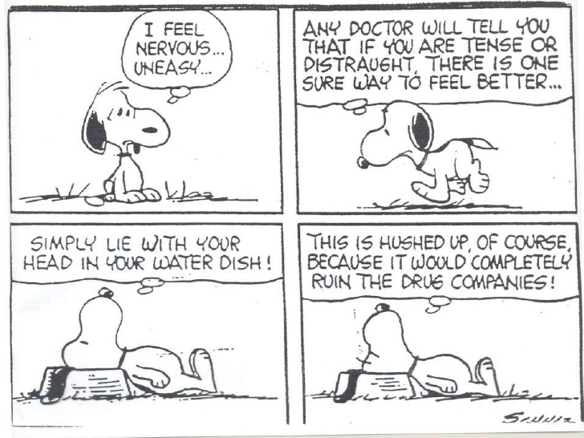
Self-Care is easier than you think!

Slide 47
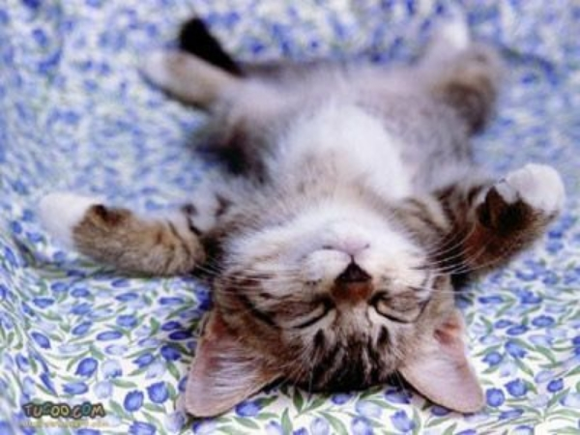
3. Developing a Self-Care Practice of Relaxation
What is your spiritual practice of relaxing?

