Slide 1
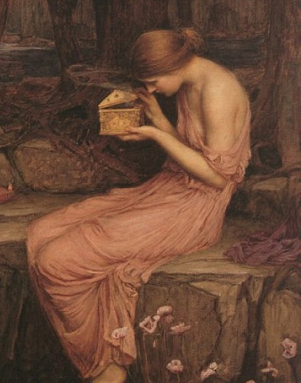
Embracing the Beauty of the Feminine: Lessons for Medicine and its Healers from the Myth of Psyche and Eros
Amy Lawson, MA, MD
August 3, 2019

Slide 2
“Myths do not ground, they open . . . We may thereby see our ordinary lives embedded in and ennobled by the dramatic and world-creative life of mythical figures.”
James Hillman, Archetypal Psychology

Slide 3
Housekeeping issues
Myth source is H.E. Butler’s translation in Erich Neumann’s Amor and Psyche: The Psychic Development of the Feminine (1956)
Although I’m speaking from a physician’s perspective, I believe my key points will be relevant for many helping professions, as well as anyone who comes in contact with our masculine medical system.

Slide 4
Interpretations of Psyche and Eros myth
von Franz: development of anima in men
Neumann: women’s development of the feminine side
Johnson: wide range of feminine psychology
Hillman: transformation through the analytical process, an initiation

Slide 5
Main theme: Psyche as healer, Eros as modern medicine
Psyche comes into her mature femininity in the myth
Modern medicine represses the feminine
Psyche’s journey back to Eros, especially her fourth labor, speaks to a healer’s maturation in the masculine field of medicine, regardless of gender

Slide 6
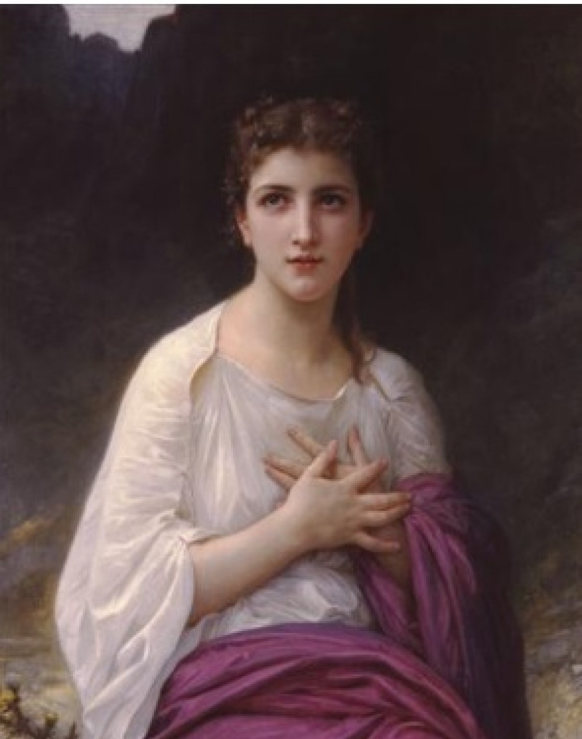
Psyche

Slide 7
Psyche
Beautiful, innocent, alone
Parallels with medical trainees
Where is the Eros who will fall in love with us?
What does my soul love?

Slide 8
Eros

Slide 9
Eros
His love is contingent on obedience
Sometimes depicted holding a butterfly and burning it with his torch
“There is no real process of individuation without the experience of love, for love tortures and purifies the soul.” (von Franz, The Golden Ass of Apuleius)
Love transforms soul; Eros transforms Psyche, but mostly in absentia

Slide 10
Eros as medicine
Requires us to do its bidding on its terms
We submit to its domination, unquestioningly following its rules, allowing ourselves to be blinded by love and good intentions, choosing to remain unconscious, just like Psyche
Parallels with medical training

Slide 11
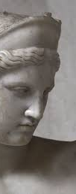
Aphrodite
“Psyche finally goes to Aphrodite’s altar, for it is almost always the case that whatever has wounded you will also be instrumental in your healing.” (Robert Johnson, She)
For Psyche, a negative mother or anima figure
Aphrodite assigns four tasks that lead toward transformation of the feminine and reunion with Eros

Slide 12
Doctors have been wounded by Aphrodite’s principles, but she can help us transform
Goddess of beauty, but also of:
Fertility
Searching for a fruitful life
Desire/pleasure
Taking pleasure in the profession
Embodied emotional experience
Reconnecting body and mind
Connection, union between opposites
Reuniting feminine and masculine in medicine

Slide 13
Psyche’s fourth labor: Retrieve beauty ointment from the underworld
The tower’s advice:
Bring 2 coins and 2 cakes
Refuse help to those who ask in order to conserve energy
Don’t feast with Persephone
Don’t open the ointment
Parallels with medicine
Learn to say no
Prepare and protect ourselves

Slide 14
Persephone’s beauty ointment: Interpretations of Psyche’s “failure”

Slide 15
Persephone’s beauty ointment: Psyche’s “failure”
Psyche’s surrender to temptation is a necessary sacrifice in service of rebirth as a more mature woman
“By preferring beauty to knowledge, she reunites herself, rather, with the feminine in her nature. . . It no longer consists in the self-contained beauty of a young girl who sees nothing beside herself. . . It is the beauty of a woman in love, who wishes to be beautiful for the beloved, for Eros, and for no one else.”

Slide 16
What does it mean for doctors to emulate Psyche’s sacrifice of knowledge for beauty?
Stop longing for “correct” answers, foolproof algorithms, one-size-fits-all medicine
See the beauty and individuality and independence of our patients
Surrender to love and connection and beauty in medicine

Slide 17
The reunion of Psyche and Eros sees them both changed
Naïve lovers → mature partners
Eros: demanding lover → redeemer
Psyche: unconscious femininity → conscious femininity
“It is always [Psyche] who undertakes, suffers, performs, and completes, and even the manifestation of the divine, of Eros, is ultimately induced by the loving and knowing activity of the feminine aspect, of the human Psyche.“ (Erich Neumann, Amor and Psyche)

Slide 18
Like Psyche, perhaps our labors to transform ourselves have the potential to transform that which we love as well. Perhaps we can begin to redeem our masculinized Western world through our work, bringing balance and maturity.

Slide 19
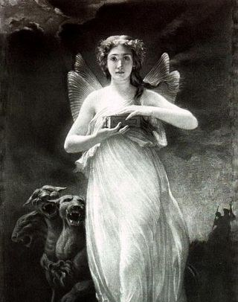
Contact information
Amy Lawson
San Francisco, CA
dnachick113@gmail.com

